Slide 1
Web Crawling
By: Luis Liang, Anahit Sarao,
Nathan Lin, Mauricio Rivera
San Jose State University, College of Engineering

Slide 2
Web Crawling
Web Crawler also known as a web spider or web robot it is ran by an automation script which searches the World WIde Web.
Examples
Ecommerce
Recruiters
Travel Companies
Media Companies
Business Directories

Slide 3
Schedule
 | Week of | Task | Notes
1 | 3/7 | Research | Weekly Meeting
2 | 3/14 | Research | Weekly Meeting
3 | 3/21 | Research | Weekly Meeting
4 | 3/28 | Program Analysis | Report on progress with programming
5 | 4/4 | Continuation on programming | Prepare demo
6 | 4/11 | Start of Final Report | Final details in demo
7 | 4/18 | Continue with Final Report | Check Final Report
8 | 4/25 | Finalizing Project Report | Turn in Final Project on 4/28
9 | 5/2 | Prepare and Finalize Presentation & Demo | Present in class

Slide 4
Plan for report and demo
Research
Work Distribution
Work on Report
Initialize Report
Finalize Report
Work on Project
Design
Programming
Validation
Present

Slide 5
Research Done
Web is a graph (nodes=pages, edges=links)
A crawler (spider) performs graph traversal (in various ways):
Central piece of a crawler is priority queue (frontier) which lists all the pages in some order
Pop the first item (highest priority) off the queue
Fetch that page ( get string which represents the html)
Save string for processing (crawler should just index the data)
Go over each string and pull out each hyperlink (all url that can be recognize)
Push them on the priority queue ( determines the order, which url will be used)
Additional checking: do not push when it has already processed (avoid duplicates)
Pop the next entry of the queue and keep going
Priority reflects different things depending on the task.
General : expect the age of the page (How long have you not crawled it? How to estimate?)
url = frontier.pop() # priority queue
html = get (url .host, url .page)
store (url, html) # save a copy
for each url in html: # add new links
Frontier push (url, time)

Slide 6
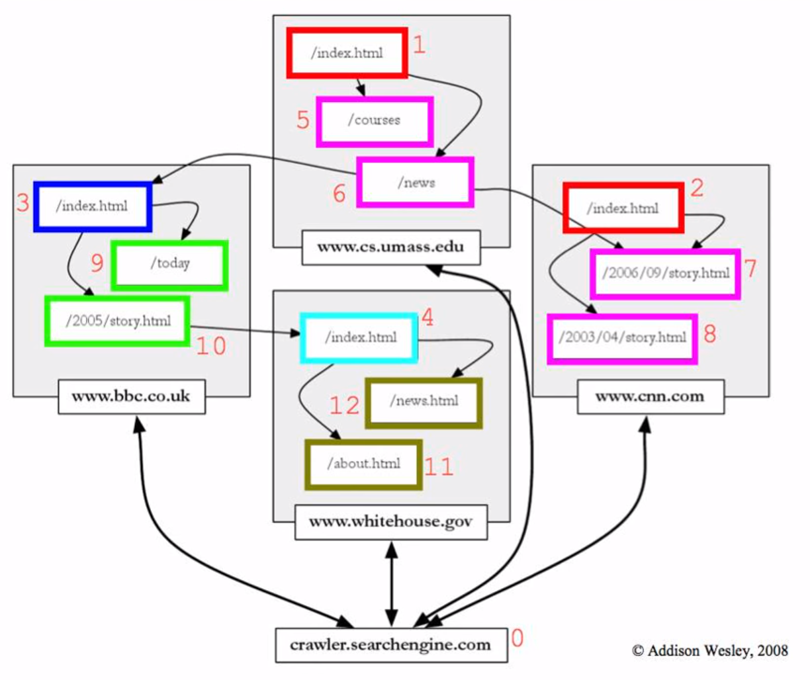
An example of traversal

